Slide 1

Netflix Recommendations
Final Project – Team Six
Alexander San Filippo
Zack Snyder
Loretta Cortez

Slide 2
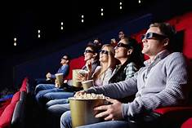
Objectives
Using a file of Netflix movie ratings, train a model that will generate movie recommendations based on user ratings.

Slide 3

Data
Movie rating files for 17,000+ movie titles, over 100 million ratings from 480,000 random, anonymous Netflix customers.
Data was collected between October 1998 and December 2005.
The ratings are on a scale from 1 to 5 stars.

Slide 4
Data Prep
Utilizing Python Pandas, data was cleaned up to reflect only those fields desired for the model testing.
File sizes exceeded Github allowances, so files were stored on Google Colab drive: https://drive.google.com/drive/folders/1AYoAIPK5G_vzh7Yu_U_Ap6DcFlYCSw6t
Once data was cleaned, testing models were created to determine the model that was the best fit.

